Slide 1

Google App Engine Tutorial
Joe Gregorio
Developer Advocate
Google App Engine
Joe Gregorio
Developer Advocate
Google App Engine

Slide 2
Building Web Apps
The challenges

Slide 3



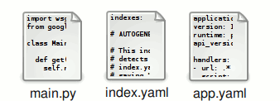



What is App Engine
Notes:
4

Slide 4
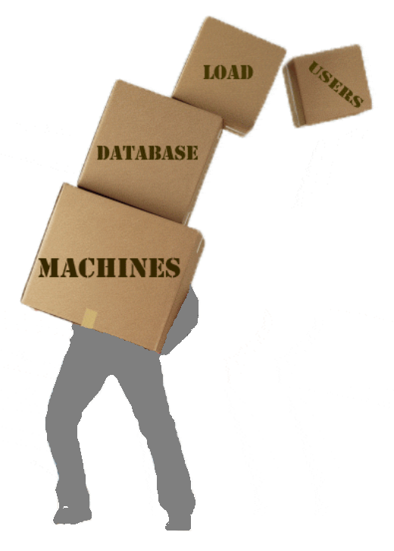
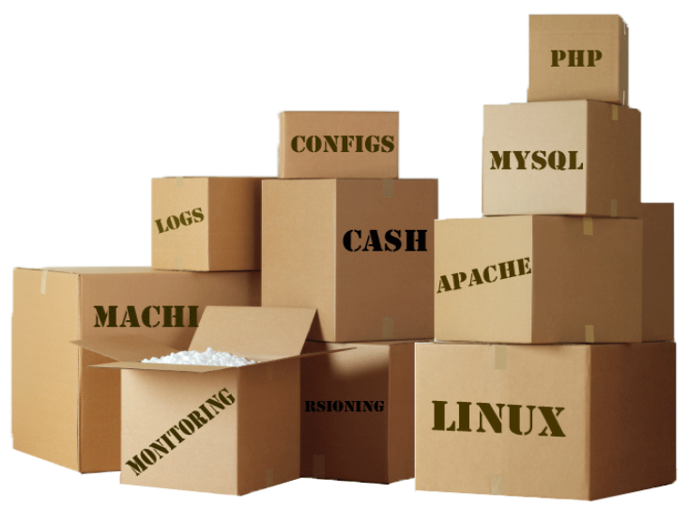
Challenges building web apps

Slide 5
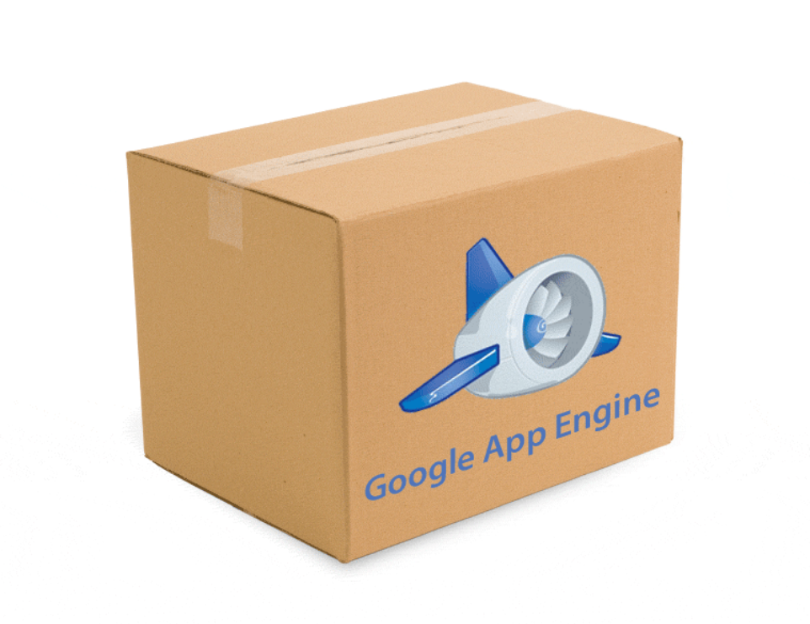
Easy to start
Easy to scale

Slide 6
The Components
The pieces of Google App Engine

Slide 7
Components
Python
Runtime
SDK
Web-based
Admin
Console
Scalable
Infrastructure
Notes:
4

Slide 8
Components
Linux
GFS
BigTable
Hardware
Scalable
Infrastructure
Notes:
4

Slide 9
Components
Python
Runtime
Batteries Included
Notes:
4

Slide 10
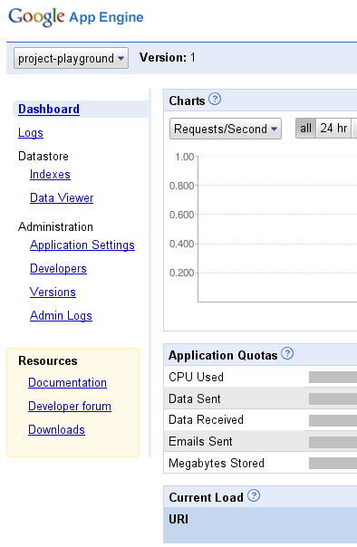
Components
Web-based
Admin
Notes:
4

Slide 11
Components
Run Locally
Easy Deploy
Manage Versions
APIs
SDK
Notes:
4

Slide 12
APIs
Software Development Kit

Slide 13
APIs
URLFetch
Email
Memcache
Datastore
Users
Images
Notes:
4

Slide 14
Current Status

Slide 15
Current Status
  Always free to get started
    1 GB storage
    1 GB/day bandwidth
    ~5 M pageviews/month
  Purchasing additional resources
    Outgoing Bandwidth $0.12/GB
    Incoming Bandwidth $0.10/GB
    CPU Time $0.10/hr
    Stored Data $0.15/GB/month
    Recipients Emailed $0.0001
Future
    More languages
    XMPP
    Large upload/download support
    Offline processing
Notes:
4

